Slide 1
Machine Learning,
Stock Analysis,
Accessibility!
By: Team Money

Slide 2





Team Members
Hayden Esman
Shilpa Agrawal
Pedro Takenouchi
Ryan Michels
Kwang Min Ko

Slide 3
Mission Statement
Private stock trading is becoming popular through apps like RobinHood and Acorn, but machine learning is not yet widely available to the public
Our goal is to create a proof of concept to show how it may be used to benefit small traders.
Notes:
"Stock analysis has been historically in the hands of statisticians and brokers, and inaccessible to many people. In the age of data science, this no longer needs to be the case. Our app aims to bring the premier analytic techniques and to compare their efficacies in order to make making intelligent stock decisions more accessible to people without a background in statistics."

Slide 4
How?
We used a variety of analytic tools, using both our own methods as well as publicly published stock analyses in order to create several models.
We then compared the efficacy of each of the models in order to find the ways they were most rigorous.

Slide 5

What is FAANG?
Notes:
FAANG is an acronym for the market’s Five most popular and best-performing tech stocks, namely Facebook, FAANG is an acronym for the market’s Five most popular and best-performing tech stocks, namely Facebook, Apple, Amazon, Netflix and Google (Alphabet).
March 2019, the market capitalization of these companies was equal to $3.1 Trillion.

Slide 6
Methodology
Random Forest (RF)
Artificial Neural Network (ANN)
Prophet
Long Short-Term Memory (LSTM)
Naive Bayes and Logistic regression
K-nearest neighbors MAs
Notes:
What are these? What are these?
How one is it different from others?
What values did we use to compare (Opening and Closing price)
How one is it different from others?
What values did we use to compare (Opening and Closing price)

Slide 7
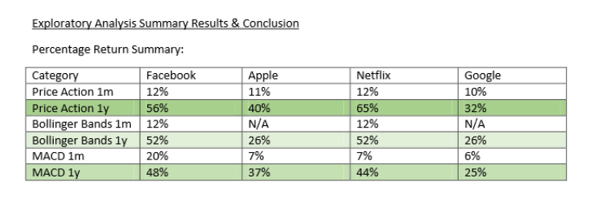
Random Forest

Slide 8
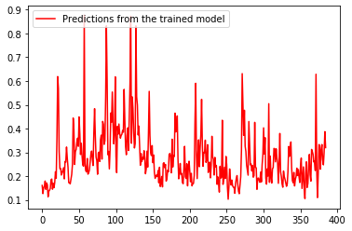
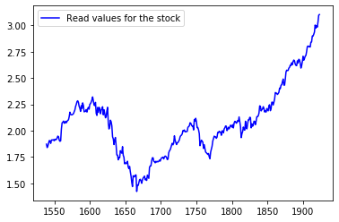
Artificial Neural Network
The predictions were not accurate and more time is needed for refinement.
Apple
Notes:
We tried to build an ANN model however it did not work well for this purpose. In machine learning that is why multiple techniques need to be tried in real life.
Artificial neural networks are one of the main tools used in machine learning. As the “neural” part of their name suggests, they are brain-inspired systems which are intended to replicate the way that we humans learn. Neural networks consist of input and output layers, as well as (in most cases) a hidden layer consisting of units that transform the input into something that the output layer can use.

Slide 9
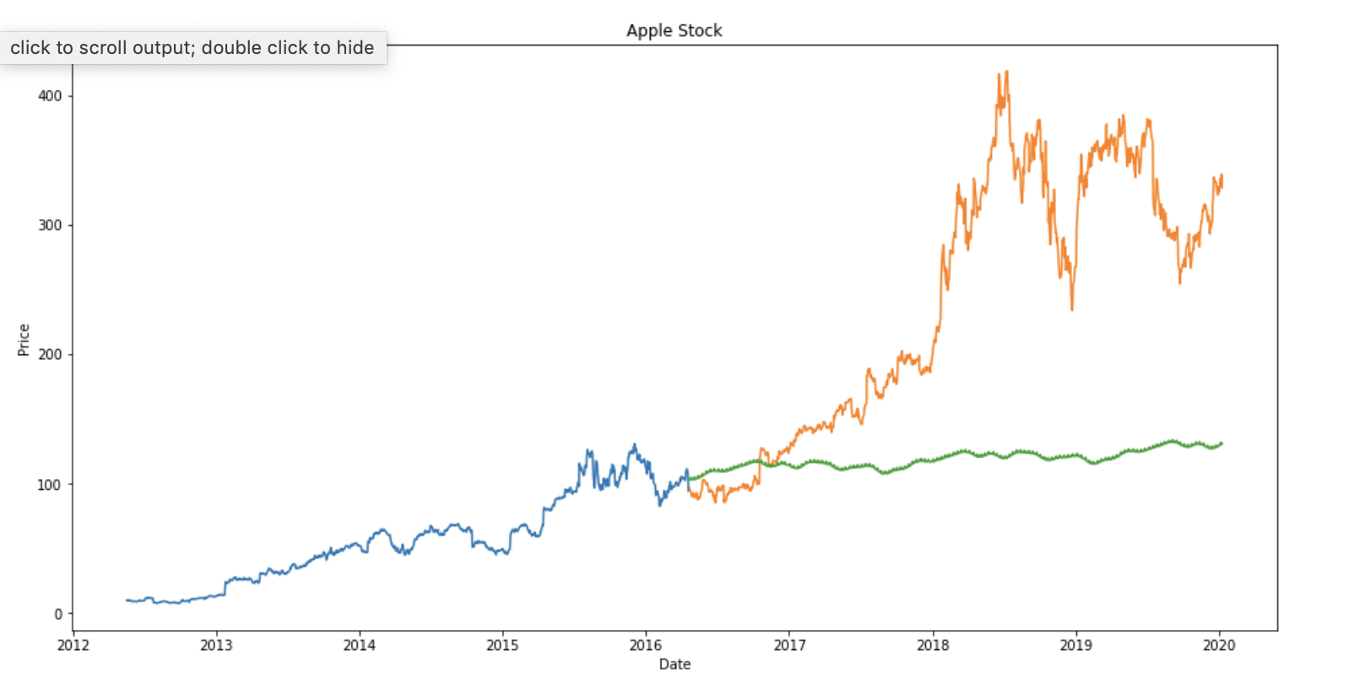
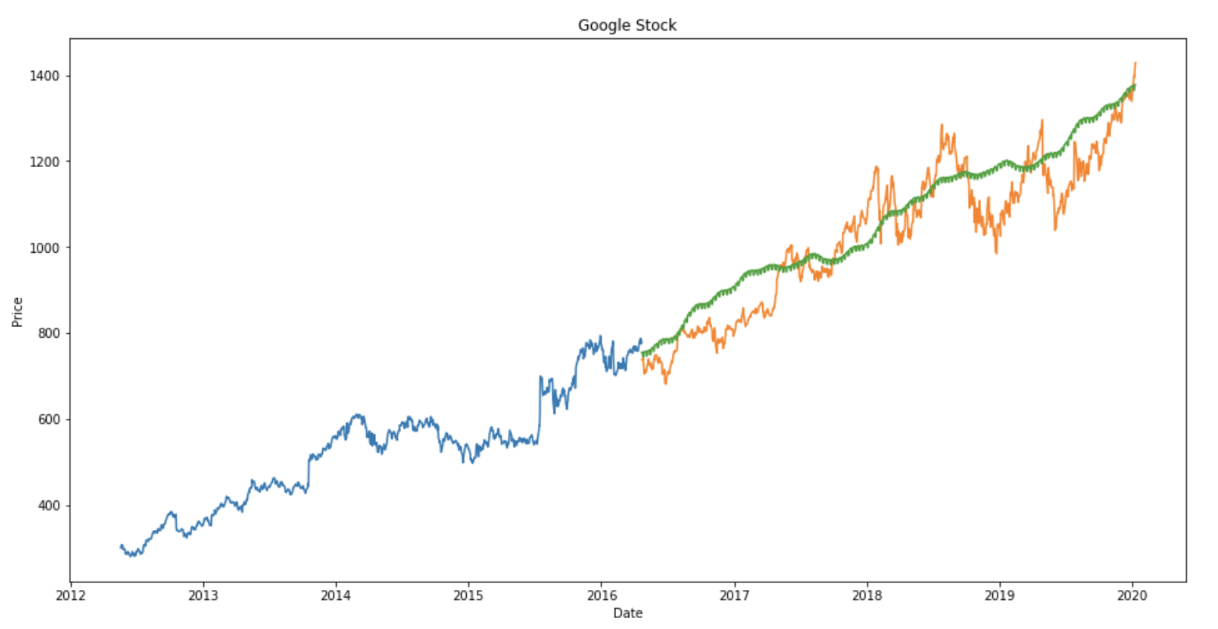
Prophet
Notes:
The Prophet captures the trend and seasonality from the data.
The graph shows why Prophet is dead, it was one of the popular stock prediction chart.
The Orange is Actual and Green is Prediction

Slide 10
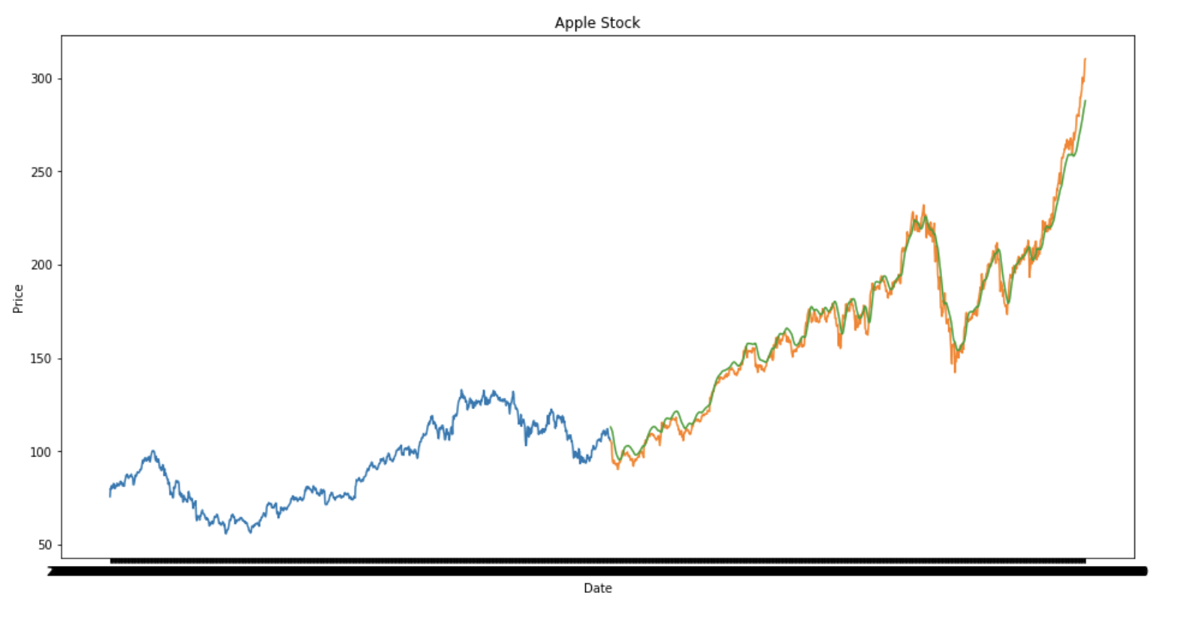
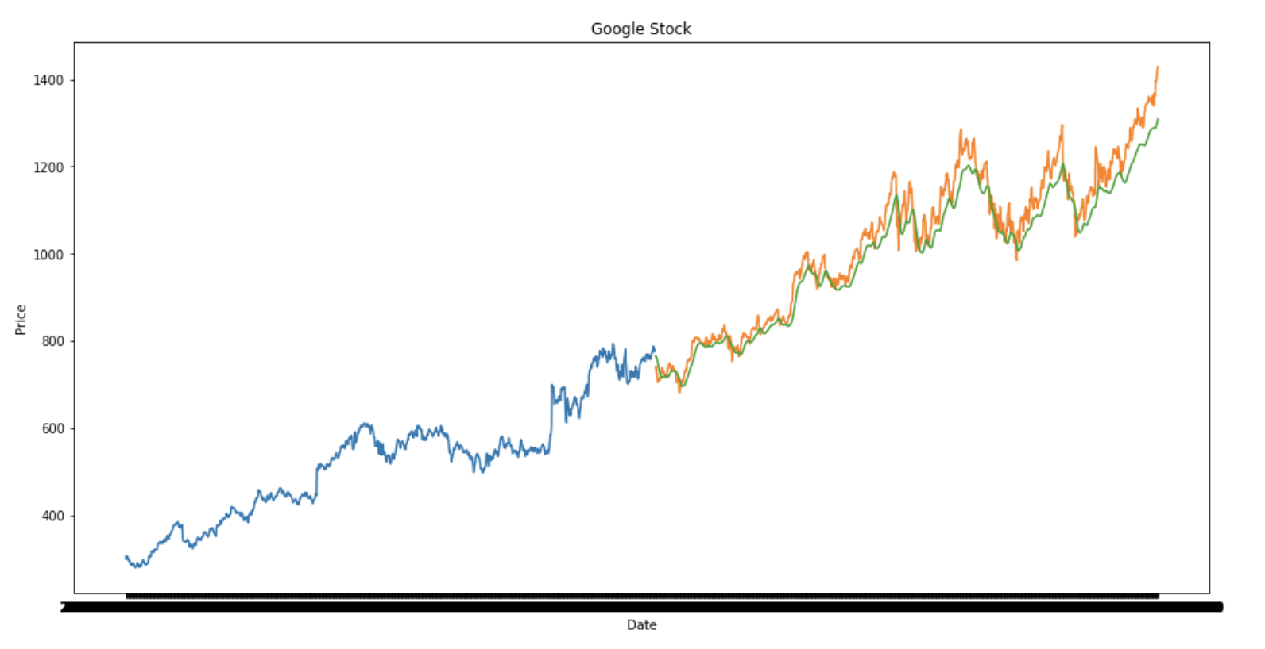
LSTM (Long Short-Term Memory)
Notes:
The Orange is Actual and Green is Prediction.
LSTM are still widely used. It is able store and divide past important information.
The graph is divided in Three gates:
1. Input gate: adds information to the cell state
2. Forget Gates: removes the information that is no longer required by model
3. Output gate: output gate at LSTM selects the information to be shown as output
It is very accurate but LSTM prediction is not enough, stock price is affected by the news about the company (Demonetization, Merger/demerger)

Slide 11
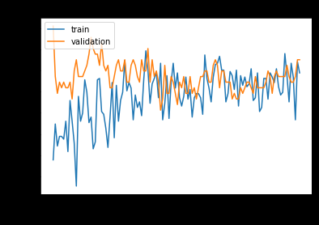
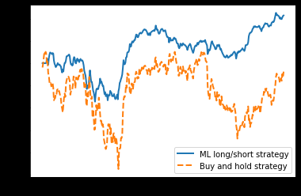
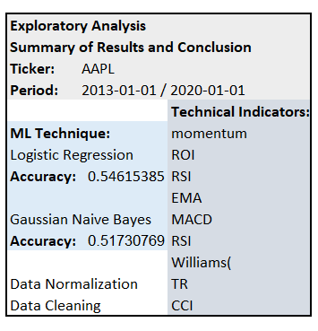
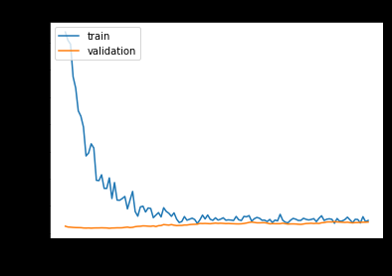
Naive Bayes & Logistic Regression / Deeptrading
MATTHEWS CORRELATION
CONFUSION MATRIX
[[0.22033898 0.69346734]
[0.18079096 0.83919598]]
CLASSIFICATION REPORT

Slide 12
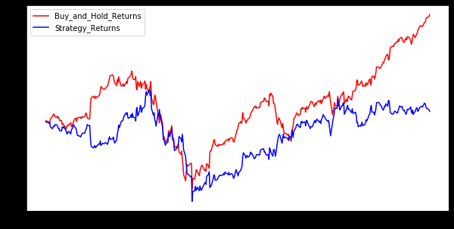
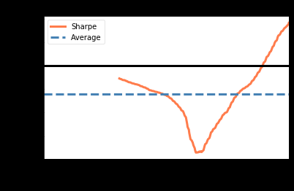
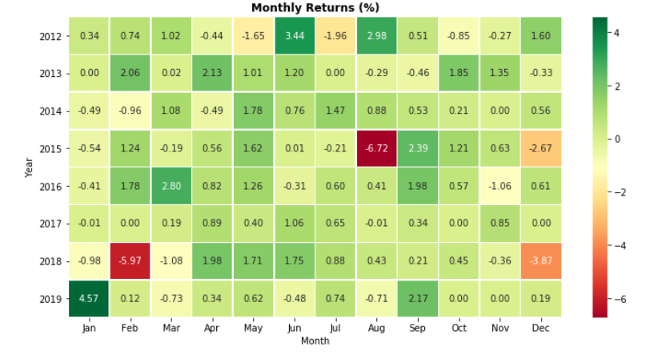
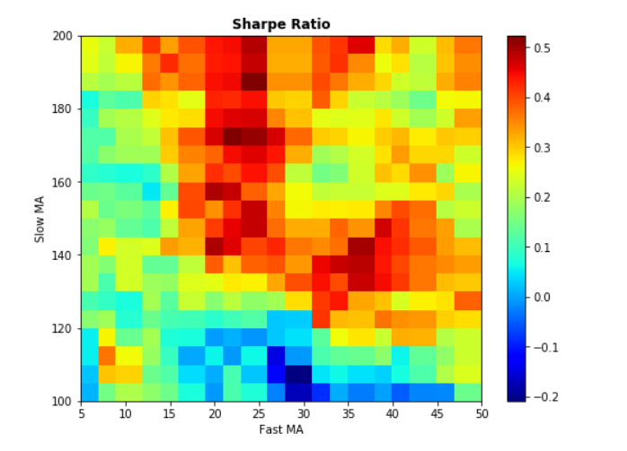
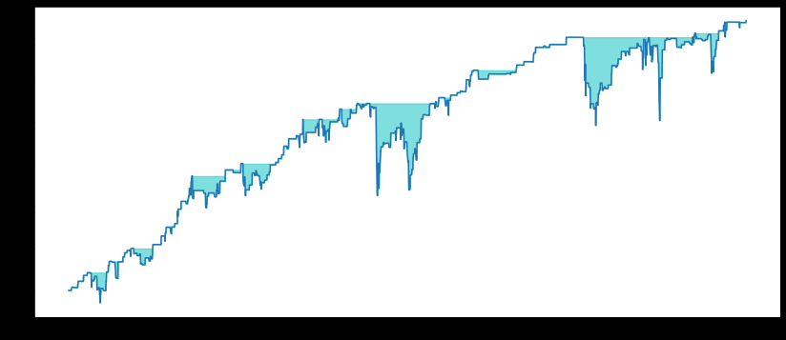
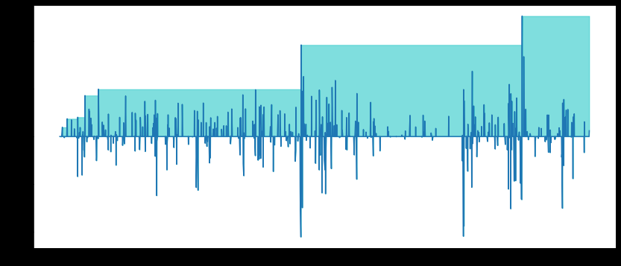
K-nearest neighbors and MAs Indicators

Slide 13
Analysis
In the cases we analysed, neural networks and prophet were unsuccessful in creating actionable insights.
LSTM and Random Forest Analyses both provided meaningful predictions.
We believe that as we analyse more companies, that there will be advantages to one model over others according to their strengths.
Notes:
Prophet and ANN are outdated they are behind in updates.
LSTM and RF the datas are accurate but they will fall behind if they are not up to date due to the fast pace stock market.

Slide 14
Conclusion
Our model will be able to recommend the best algorithm to use according to the type of investor and the relevant industry.
Using publicly sourced algorithms will allow us to organize these powerful tools so that they are usable by non-statisticians

Slide 15
References:
https://github.com/NeilPrabhu/Stock-Prediction
https://github.com/huseinzol05/Stock-Prediction-Models
https://github.com/LiamConnell/tradetest/blob/master/EntireProcess/youngbuck_sharpe.ipynb
https://github.com/Rachnog/Deep-Trading
https://blog.quantinsti.com/machine-learning-k-nearest-neighbors-knn-algorithm-python/
https://machinelearningmastery.com/tutorial-to-implement-k-nearest-neighbors-in-python-from-scratch/
https://www.jasonlee.mobi/projects/2018/7/8/k-nearest-neighbors-knn-algorithm-in-python
https://github.com/ranaroussi

